Slide 1
Battlebot 3 progress report
Ivan Albert, Cole Trugman, Nishagar raventhiran

Slide 2
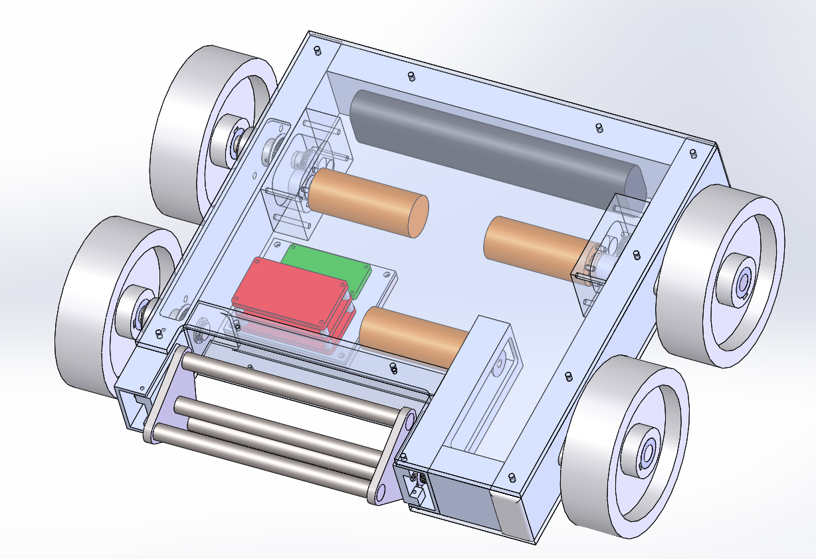
Assembly

Slide 3
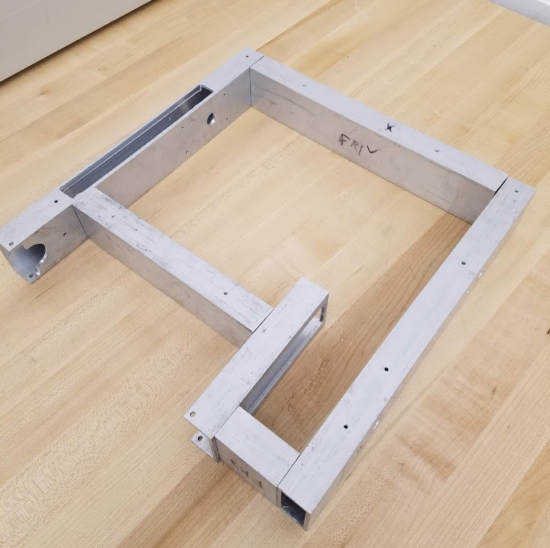
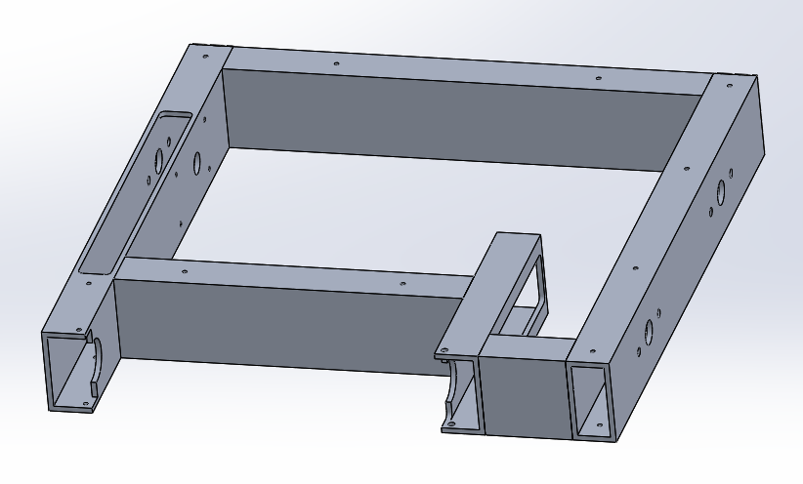
Manufactured Parts: Frame

Slide 4
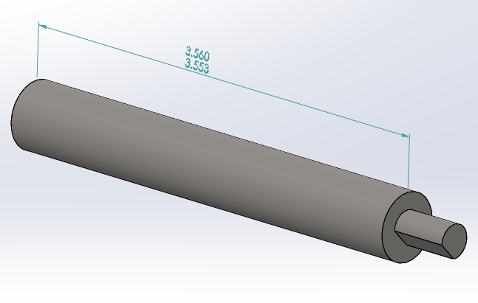
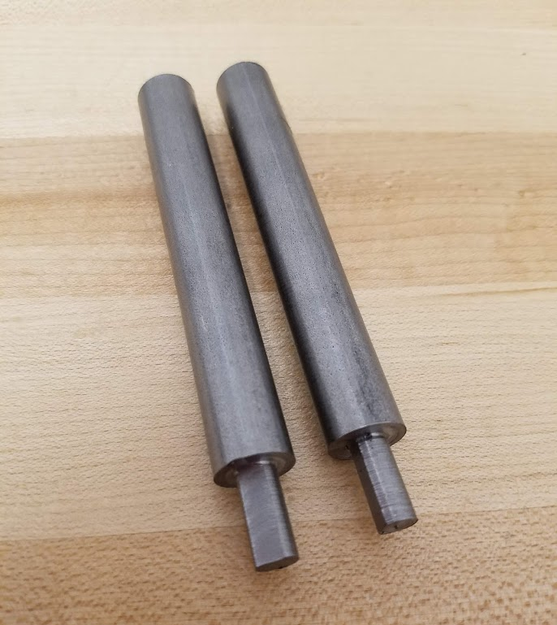
Manufactured parts: Rear axle

Slide 5
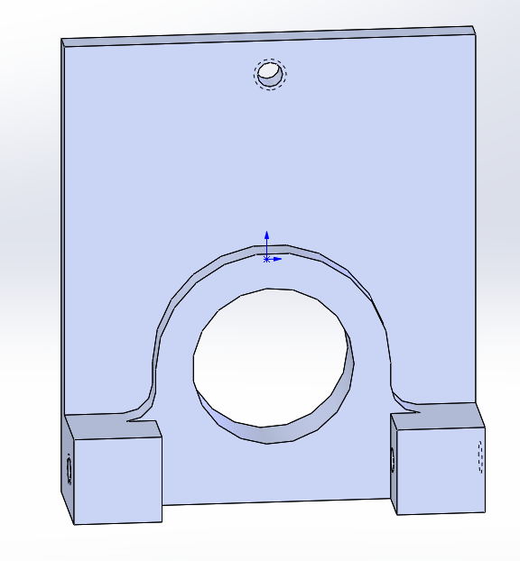
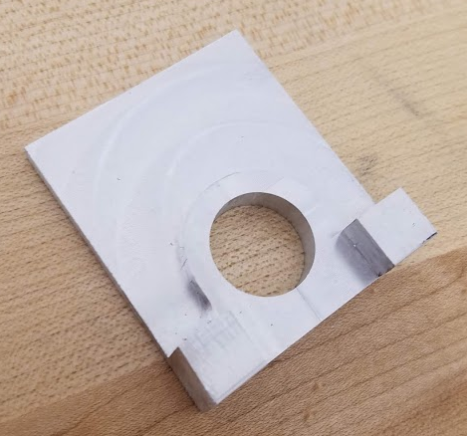
Manufactured parts: Weapon brackets

Slide 6
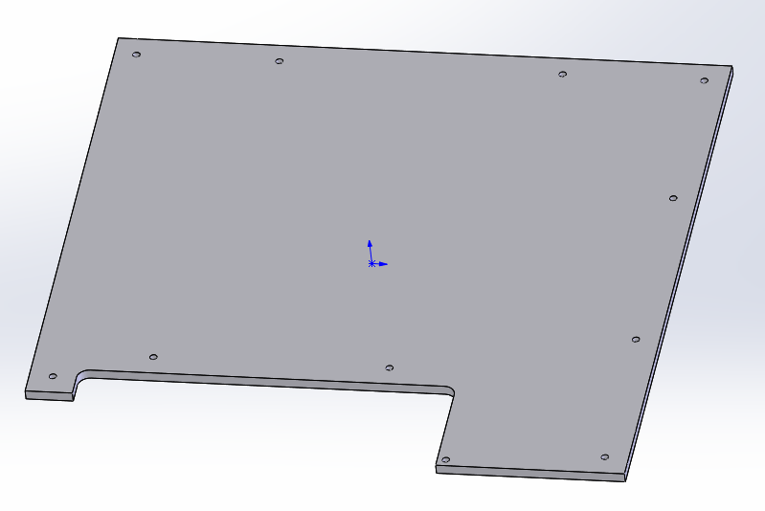
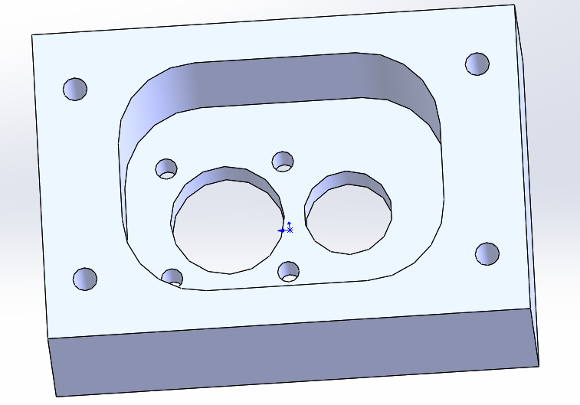
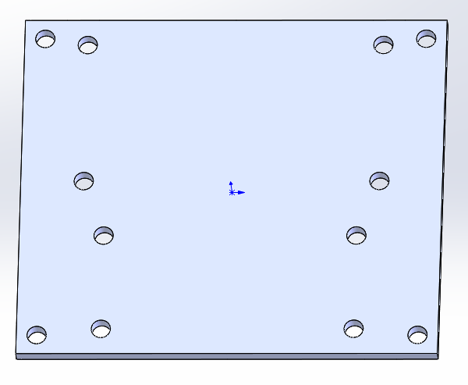
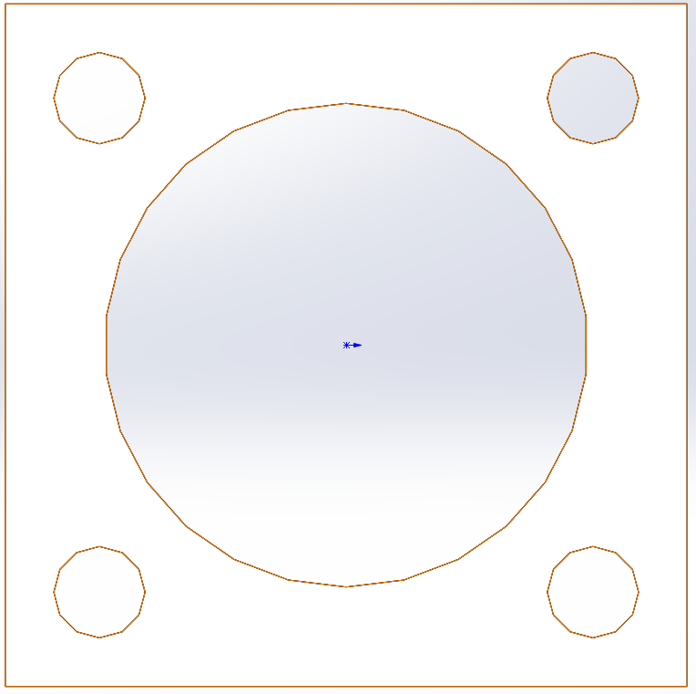
Upcoming manufactured Parts
<= Armor Plate
Gear Box =>
<= Electrical Mount
Motor Mount =>

Slide 7
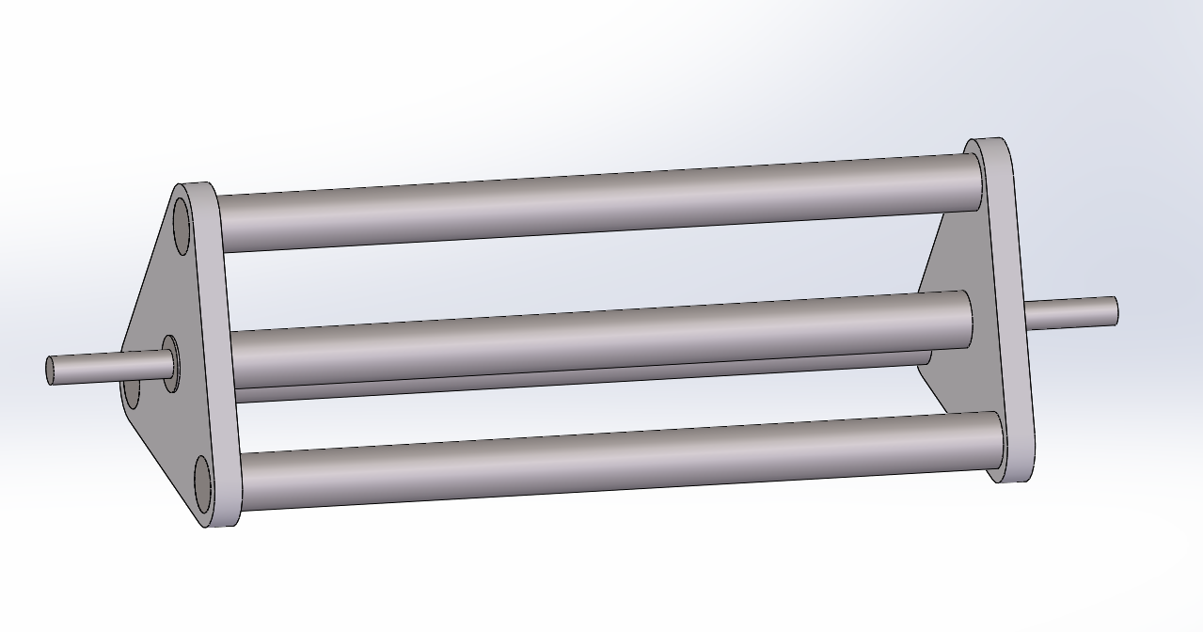
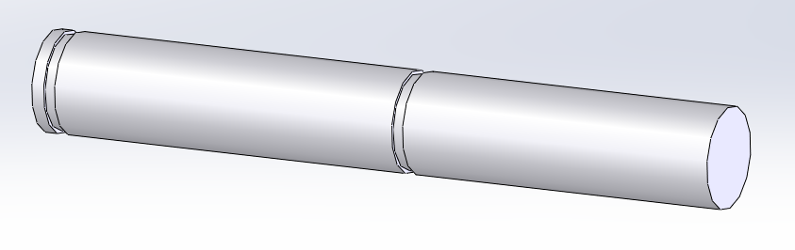
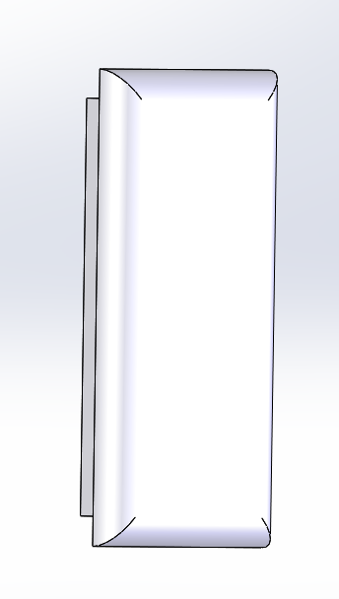
Upcoming manufactured Parts
<= Weapon Subassembly
<= Front Axles
<=Frame Caps

Slide 8
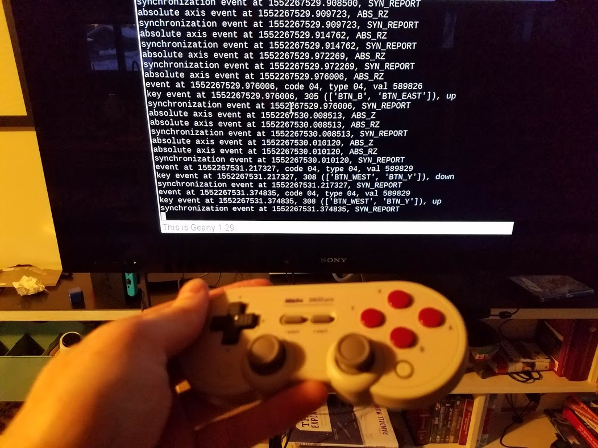
Electronics/Programming

Slide 9
This Week
Laser cut Armor Plate, Electrical Mount, Motor Mount
Machine Gear Box
Print Frame Caps
Machine Front Axles
Weld Frame

Slide 10
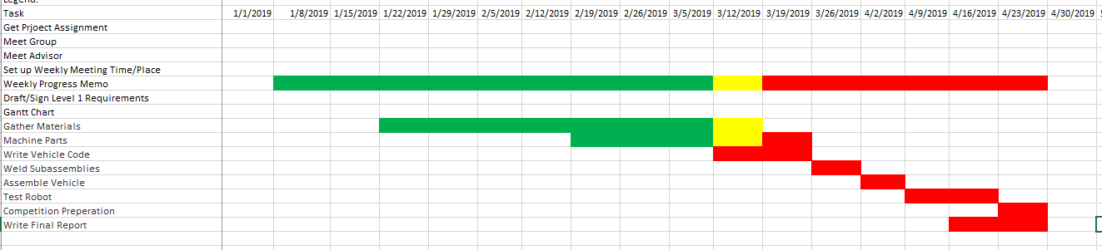
Gantt chart

Slide 11
Questions?

